Slide 1
Eurasian Connections and New Traditions
Chinese Philosophies
Imperial Systems

Slide 2
Chinese Philosophies
Confucianism, Confucius
  The Analects
    ren
    li
    xiao , or Filial Piety
Daoism, Laozi
  Dao
Legalism

Slide 3
Imperial Systems
Qin Dynasty (221-202 B.C.E.)
  Emperor Qin Shi Huangdi
    Great Wall of China
    Tomb of terracotta warriors
Han Dynasty (202 B.C.E.-220 C.E.)
  Emperor Han Wudi and land gained
  Development of Civil Service
    Mandarins
  Silk Road
  Technological Advances

Slide 4
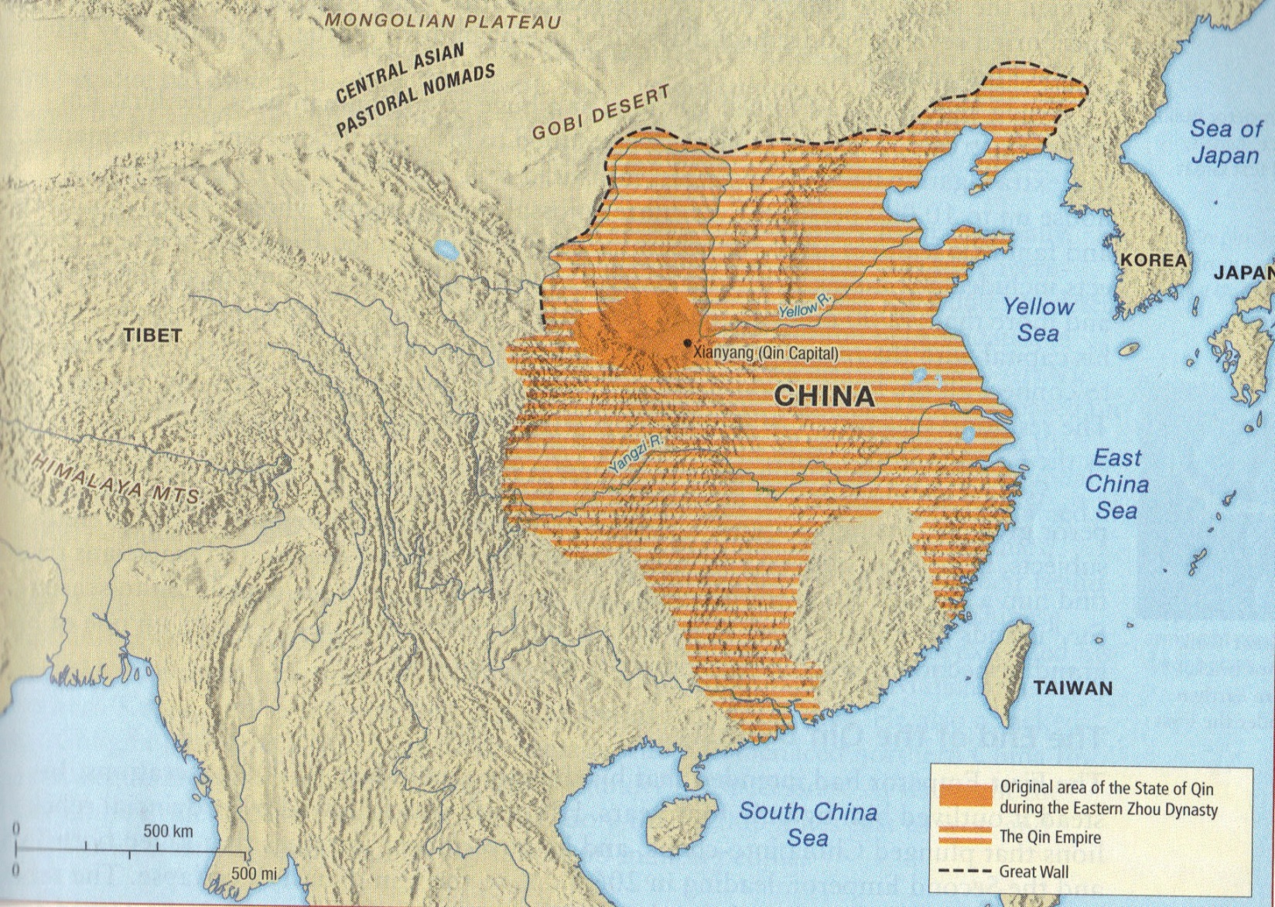

Slide 5
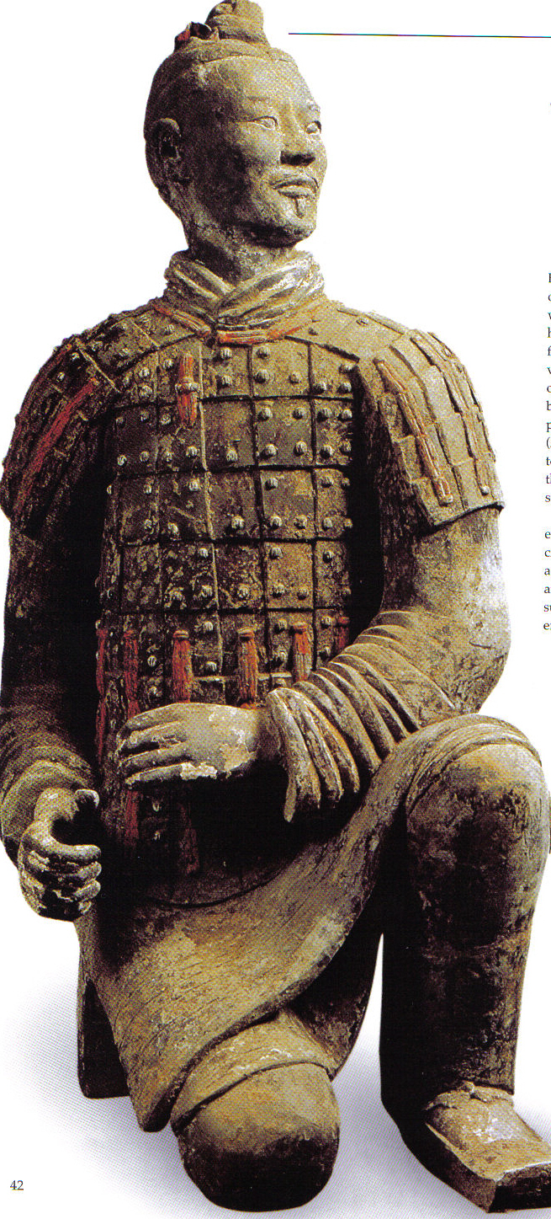
Qin Dynasty Archer

Slide 6
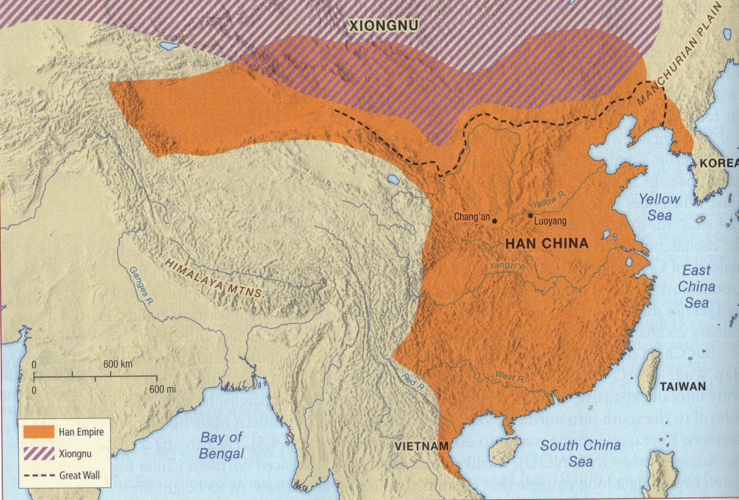

Slide 7
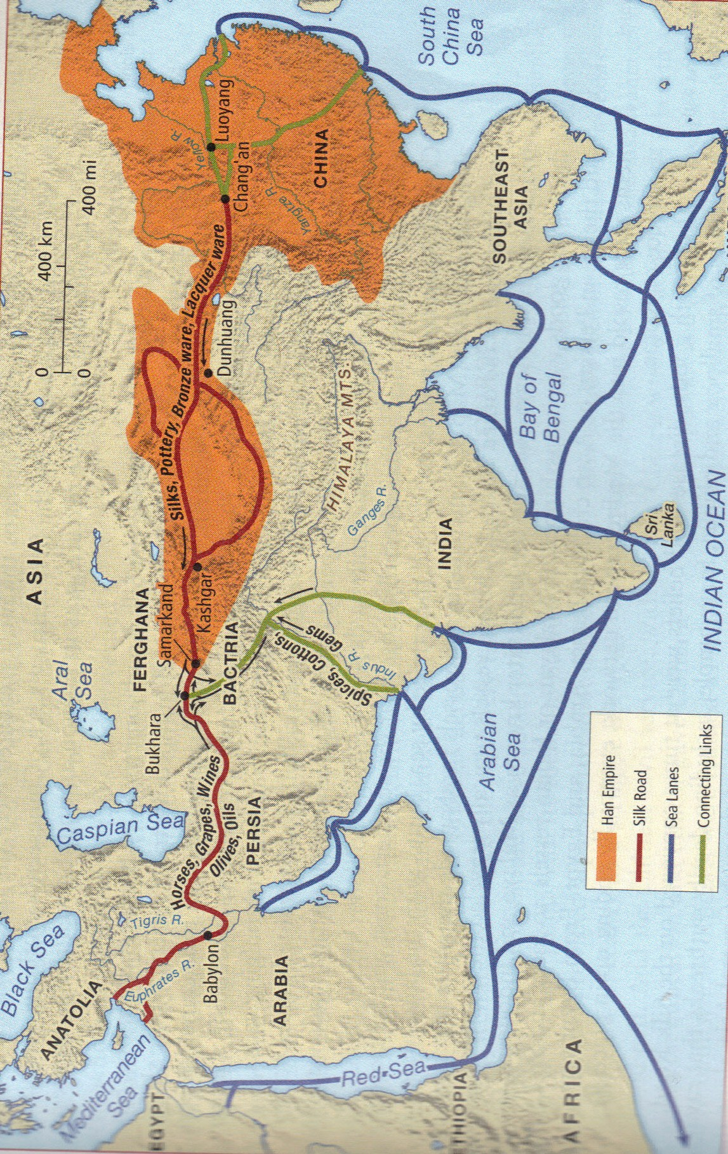

Slide 8
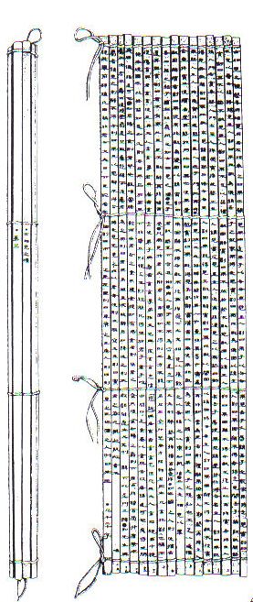
Han Dynasty text

